Slide 1
Goodfellas
IS436 - 03
PAUL, BENJAMIN,DENSU, JAS, NIELS, TANNER, WILL, ZACH

Slide 2
Data Modeling and Starting Design
Deliverable 4
05-09-2019

Slide 3
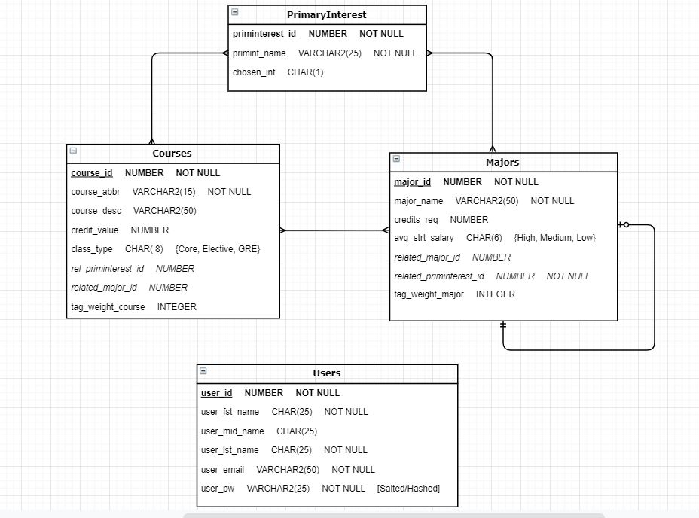
Entity Relationship Diagram

Slide 4
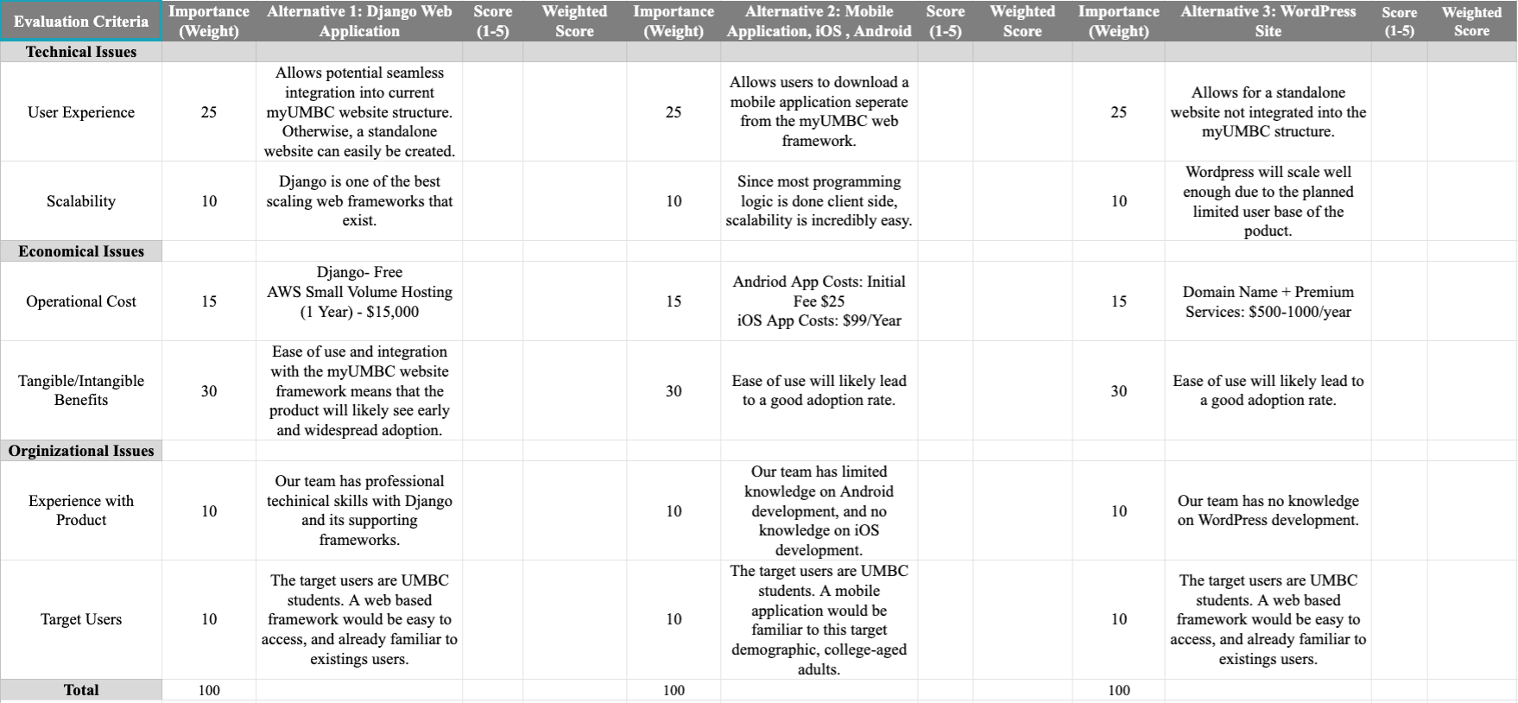
Alternative Matrix

Slide 5
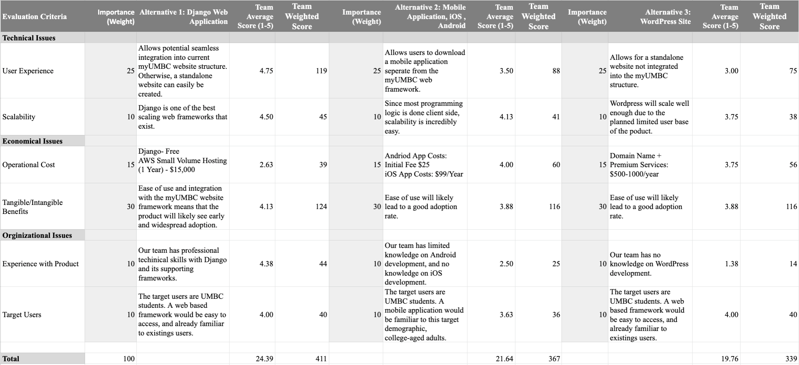
Team Alternative Matrix

Slide 6
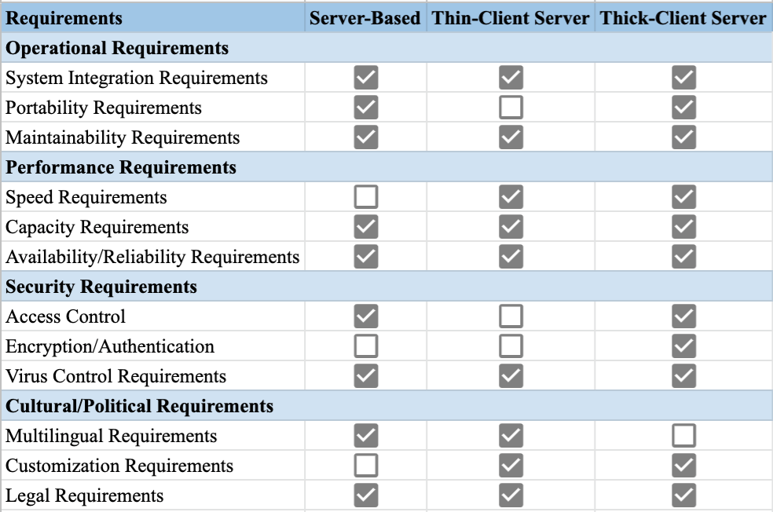
Architectural Matrix
Notes:
Operational
System Integration - Integration with exisitng systems
Portability - Device Accessibility
Maintainability - Making changes

Slide 7
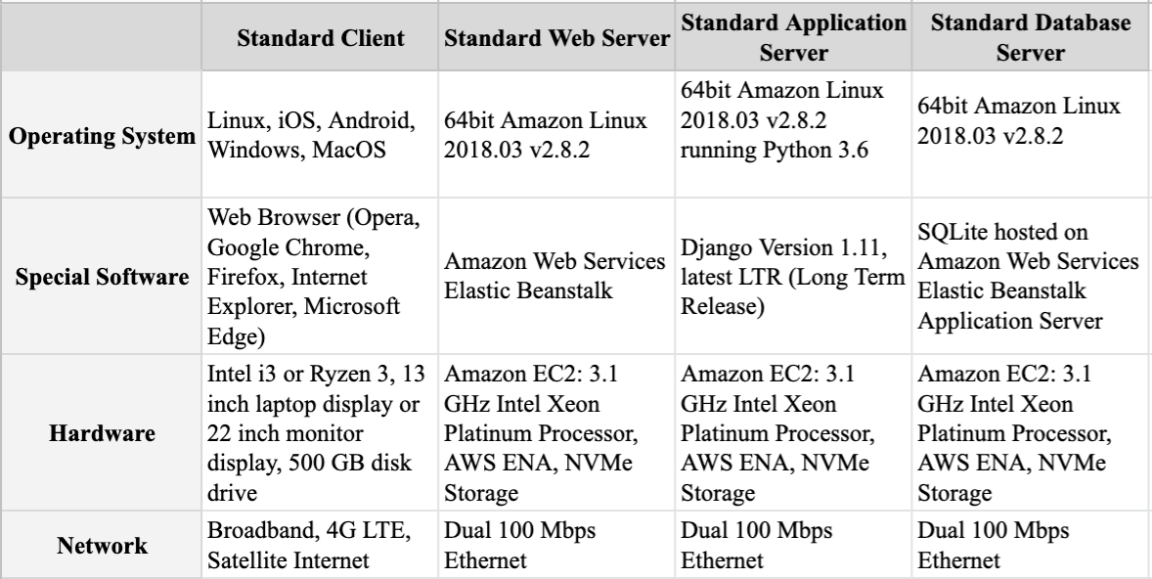
Software and Hardware Specifications

Slide 8
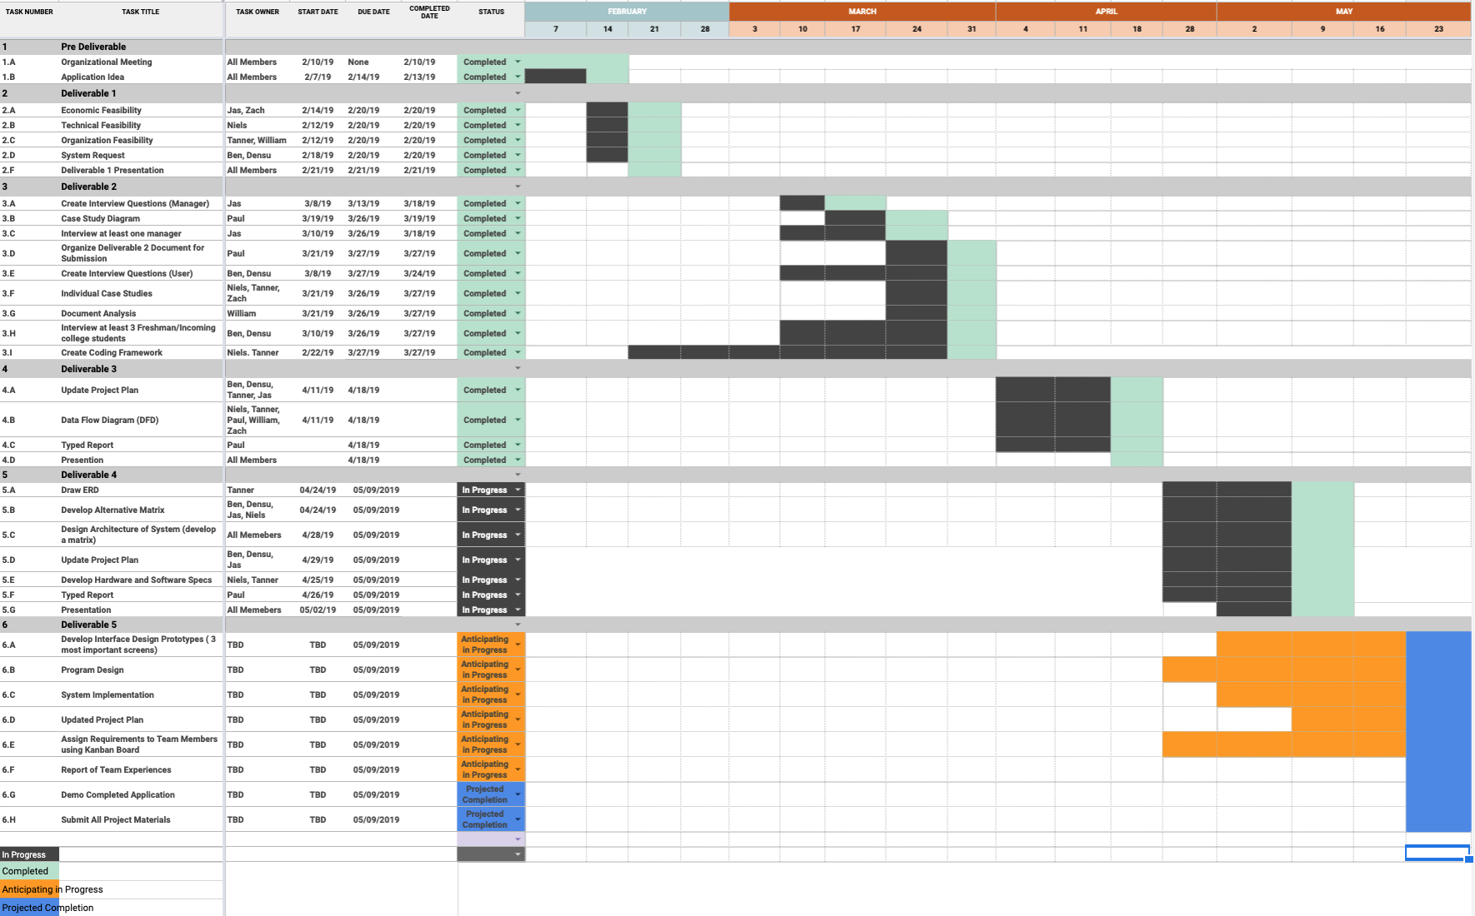
Updated - Project Plan

Slide 9
Kanban Flow - Link
https://kanbanflow.com/board/sPos7f

Slide 10
Questions??

Slide 11
THANK YOU!

